Slide 1
Module 7

Slide 2
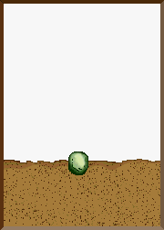
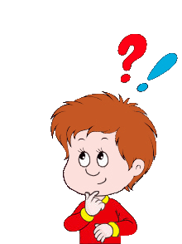
Let us study growth dependent movements :
Movement or growth of any part of plant in response to an external stimulus is called Growth dependent movement or Tropism
Movement in a seedling is always growth dependent
Who shows growth dependent movement ?
What is growth dependent movement ?

Slide 3
Movement or growth of any part of plant in response to an external stimulus is called Growth dependent movement or Tropism
Photo means light. So movement towards light.
Plant show Four types tropism
Chemo means chemicals. So movement towards chemicals.
Phototropism
Chemotropism
Gravi means gravity. So movement towards gravity.
Gravitropism
Hydro means water. So movement towards water.
Hydrotropism

Slide 4
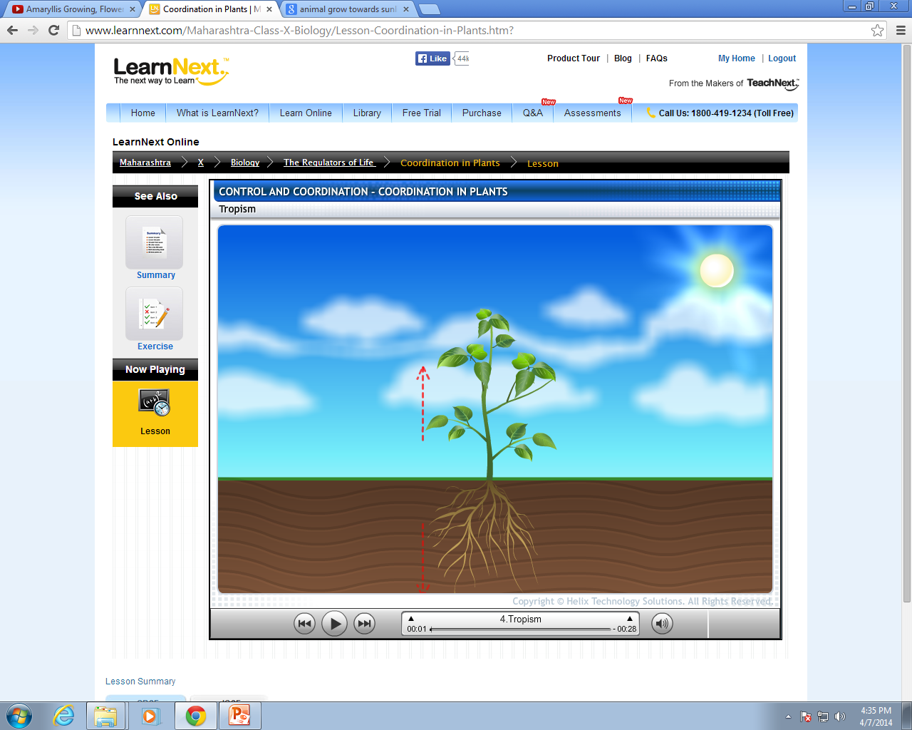
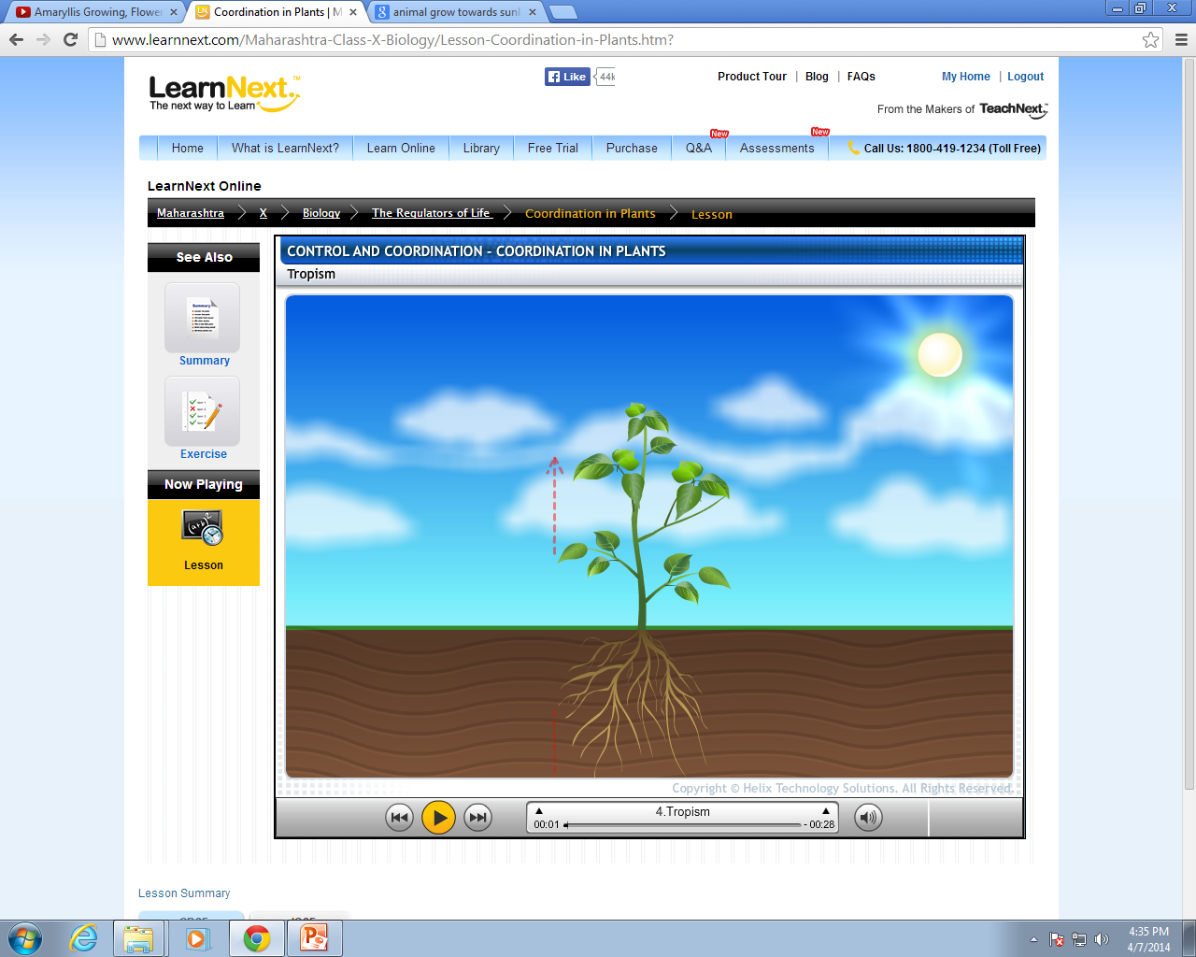








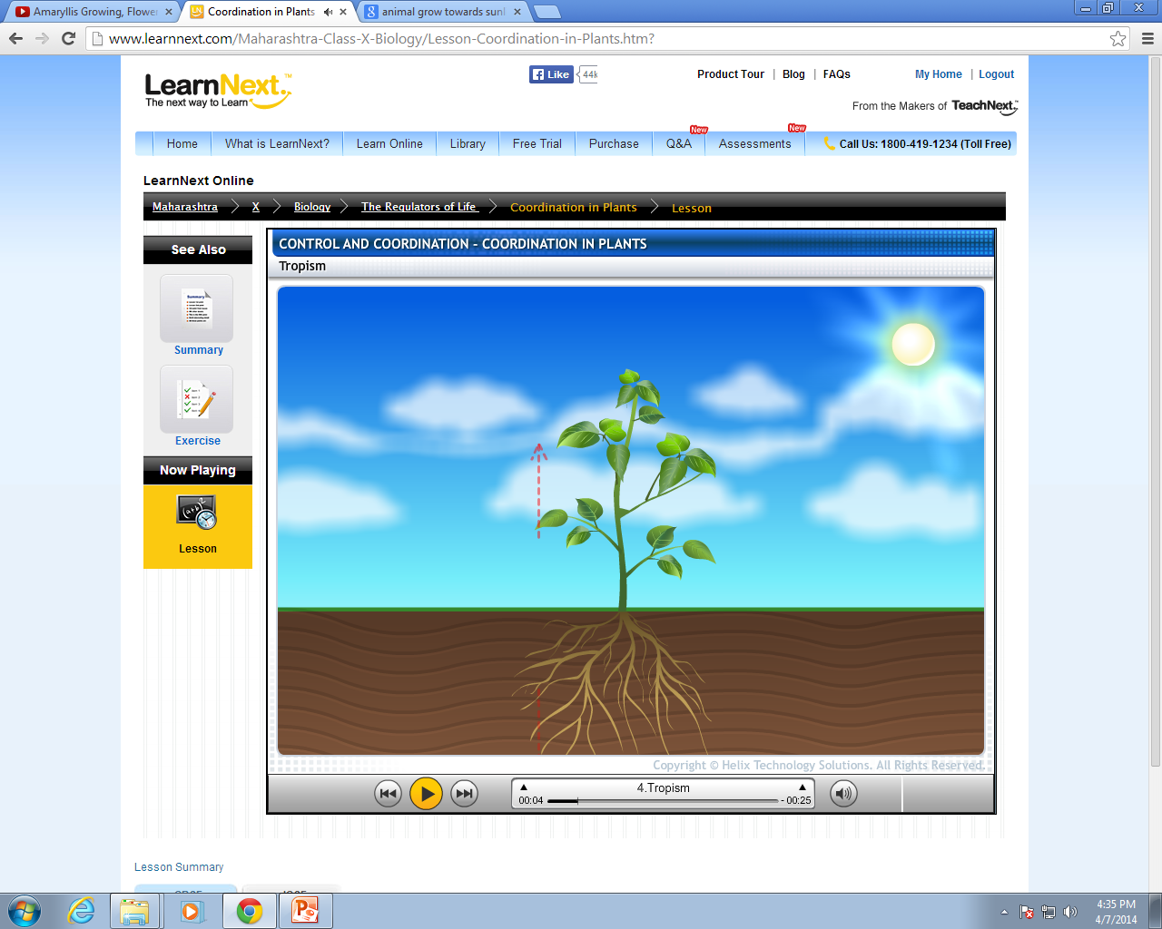


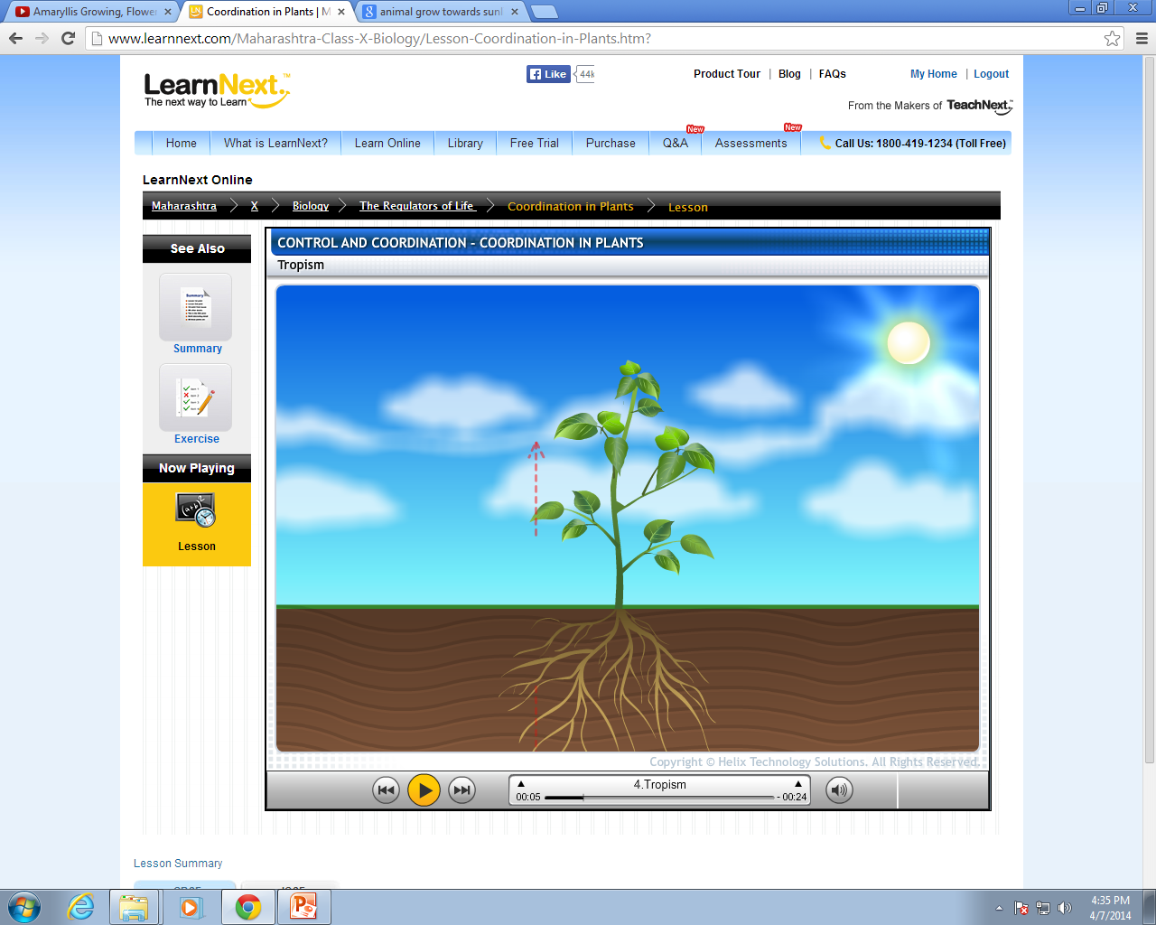




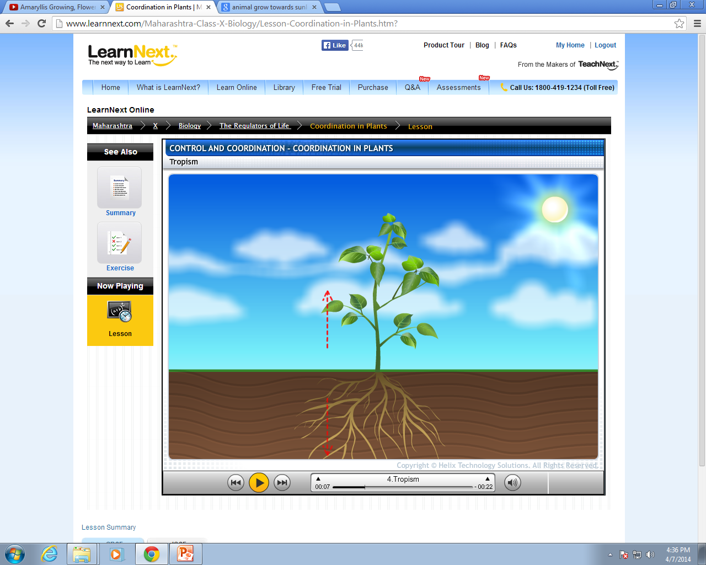






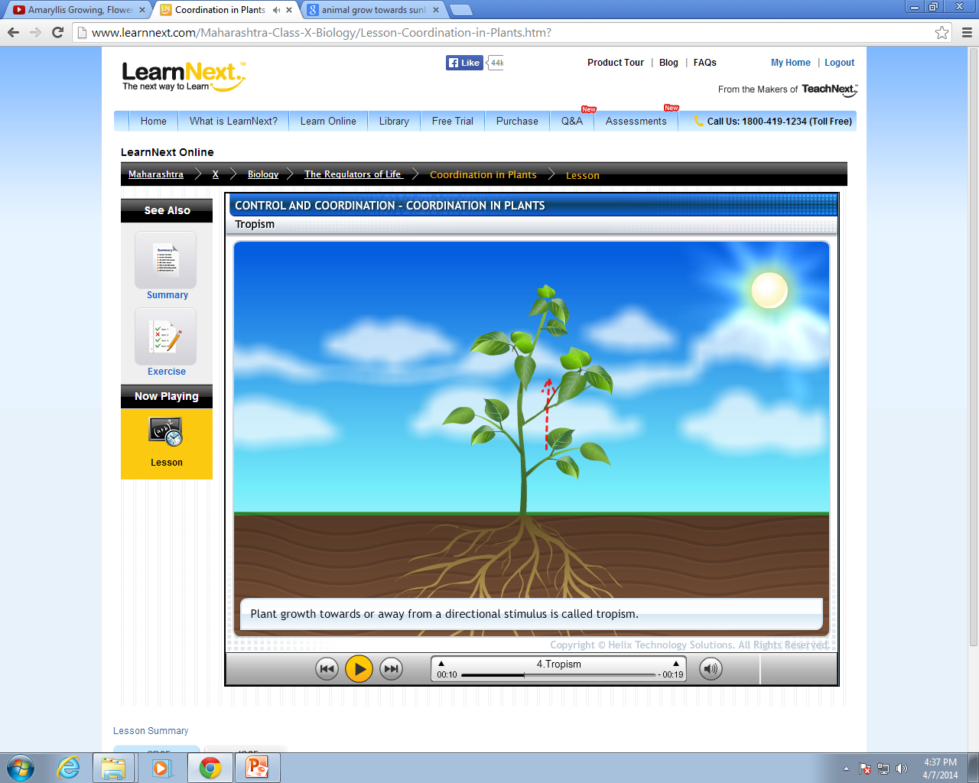













Let us magnify the upper end of the stem
Let us see why does this happen
Phototropism :
The shoot system of any plant responds towards the stimulus of light i.e. it grows in the direction of source of light. This movement exhibited by the plant is called phototropic movement
At the tip of the stem there
is a hormone called as Auxin
Auxin causes the cells of the stem to elongate
Auxin is sensitive to light
Auxin
As the unidirectional sunlight falls on the sunny side
This causes difference in length of both the sides
Make long
The auxin diffuses towards the opposite side
Leading the stem to bend towards the sunlight
Light coming from one direction
Shady side
Sunny side

Slide 5
Thank You

